Slide 1
LDF Data Platform LDF Core Team Meeting
8th September 2023

Slide 2
Agenda
1
Status Update LDF Data Platform
2
Synergies of LDF Data Platform within SDC
3
Introduction to Hybrid Architecture Concept
4
Project Ambition Fiscal Year 2024

Slide 3
Agenda
1
Status Update LDF Data Platform
2
Synergies of LDF Data Platform within SDC
3
Introduction to Hybrid Architecture Concept
4
Project Ambition Fiscal Year 2024

Slide 4



1 | Status Update LDF Data Platform Becoming a Data Driven Company
THE LDF DATA PLATFORM
Brings together what belongs together for a seamless user experience
ENSURE
Fit-for-Purpose
FASTER
Time-to-Market
CLOSE
White Spots
DRIVE
Cost Savings
PUSH
Start-up Collab
PROVIDE
SDC Interoperability
FOLLOW
SaaS first Approach
PREVENT
Vendor Lock-in
Notes:
Left side
Ensure Fit-for Purpose: Tailored to meet your specific business needs, the Data Platform ensures every solution is precisely designed for its intended purpose.
Faster Time-to-Market: Accelerate the innovation journey with a platform designed for rapid development and deployment, getting your products and services faster to market.
Push Start-up Collabo: Foster collaboration and partnership opportunities with startups to drive innovation and growth.
Provide SDC Interoperability: Seamlessly integrate and communicate with existing systems, enhancing collaboration and information flow across BUs.
Right side
Close White Spots:The Data Platform focuses on augmenting the existing services and filling white spots.
Drive Cost Savings: Optimize resources and scale as required, keeping expenses in check and ensuring efficient resource allocation based on individual use cases.
Follow SaaS first Approach: Embrace a Software-as-a-Service (SaaS) mindset, reducing the overhead of maintenance and enabling you to focus on your core business.
Prevent Vendor Lock-in: Embrace a flexible ecosystem with a diverse range of solutions, avoiding dependency on a single vendor and ensuring freedom of choice.

Slide 5


1 | Overall Project Status Milestone and Deliverables Plan
Sprint 1
Sprint 2
Sprint 3
Sprint 4
Sprint 5
May
June
July
August
September
Conceptual Design tool
Plan for self-service tool
Data sharing with externals
1st Conceptual Design
Plan for SnapLogic PoC
Plan for Data Catalog PoC
Plan for Data Observability
Design for self-service tool
Data Catalog Workshop with Atlan
POC with SnapLogic (Data ingestion)
Self-service
S3 buckets
Monitoring (Datadog)
Conceptual Design Workshop
Self-service enhancements
Manage business logic in Step functions
Siemens look & feel
Continue Conceptual Design + Logical Design
Self-service enhancements
---
POC - Data catalog (Atlan)
DataVault automation
POC - Data observability

Slide 6
Agenda
1
Status Update LDF Data Platform
2
Synergies of LDF Data Platform within SDC
3
Introduction to Hybrid Architecture Concept
4
Project Ambition Fiscal Year 2024

Slide 7






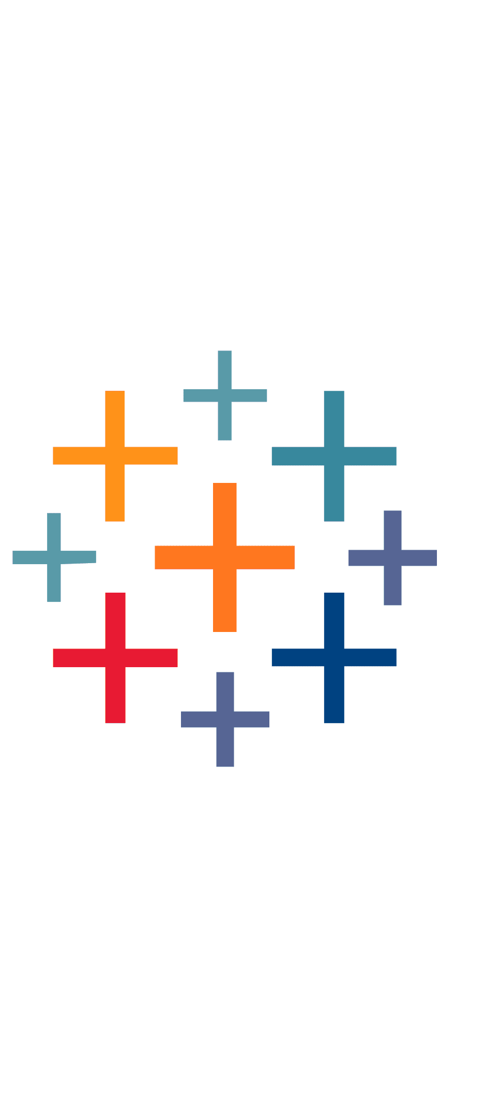








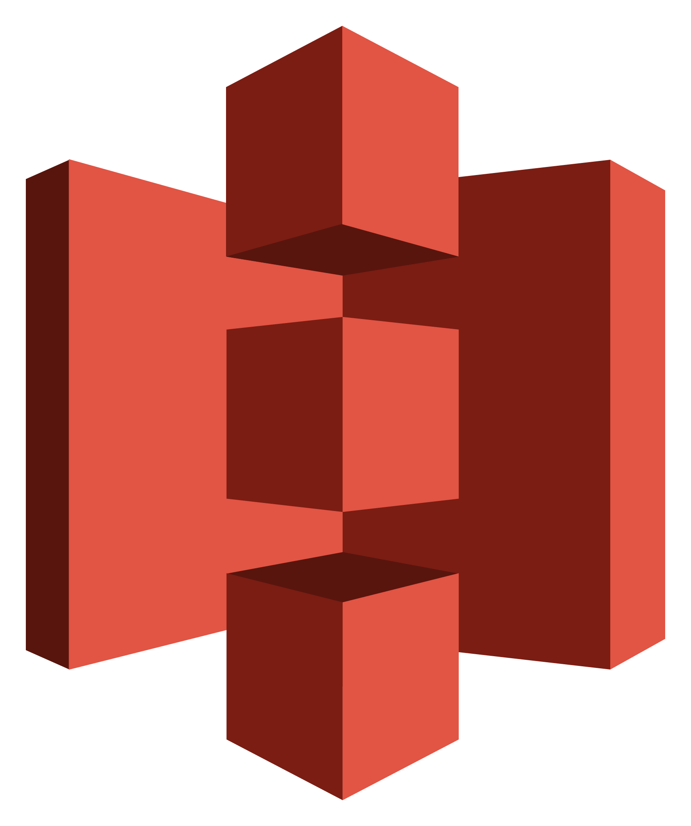

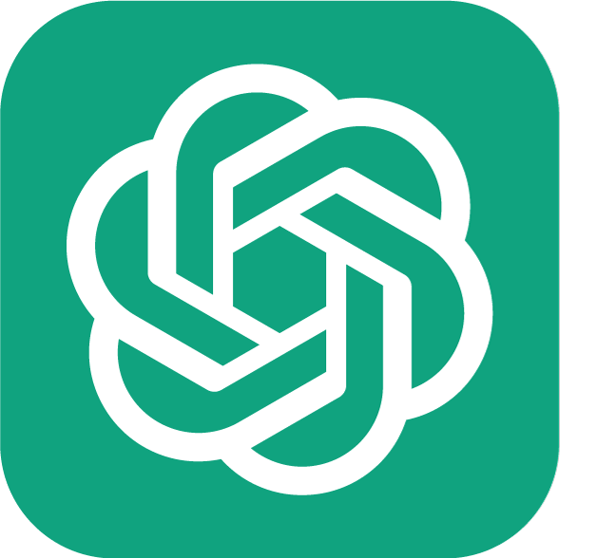

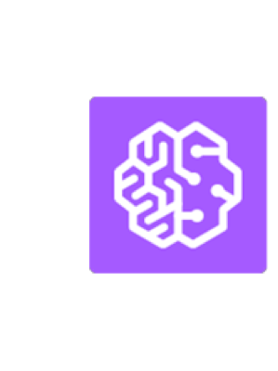

2 | Synergies of LDF Data Platform within SDC Full integration of IoT Data Lake into open data ecosystem
LDF
SDC
Data Sources
Data (Pre-) Processing
Data Storage
Federated Query Engine
Data Consumption
ERP
SCM
PLM
..
Data Analytics
Tester
Tester
100010
101001
Data Services
01011010101011101010
100101
100110
Data
Pipelines
11010101011101001
010101
100010
Machine
0101010101010101010111
101010
100101
100100111001101
010101
010101
101001
101010
100110
010101
…
Data Science
Machine
Other
Shopfloor data
IoT Data Lake
Snowflake is the platform of choice to create synergies by:
Native support for Iceberg tables in Snowflake
Zero-ETL – easy queries and joining multiple data sources inside Snowflake
No data silos - Integrated data service and analytics platform

Slide 8
2 | Synergies of LDF Data Platform within SDC Full integration of IoT Data Lake into open data ecosystem
LDF
SDC
Data Sources
Data (Pre-) Processing
Data Storage
Federated Query Engine
Data Consumption
ERP
SCM
PLM
..
Data Analytics
Tester
Tester
100010
101001
Data Services
01011010101011101010
100101
100110
Data
Pipelines
11010101011101001
010101
100010
Machine
0101010101010101010111
101010
100101
100100111001101
010101
010101
101001
101010
100110
010101
…
Data Science
Machine
Other
Shopfloor data
IoT Data Lake
By utilizing Icerberg Table Format the LDF Data Platform aligns with the most recent approval from SDC
Link to SDC Approcal: https://wiki.siemens.com/pages/viewpage.action?pageId=371235852

Slide 9







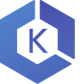

2 | Synergies of LDF Data Platform within SDC Main general aspects that we see on current data landscape
Technology that works together
Major players competing along cost and innovation fronts
Move towards interoperability and cultivate a toolchain that facilitates seamless native connections.
Every cloud vendor recognizes data as a key asset and has launched innovation initiatives on data processing and analysis.
Common storage initiatives
Scalability and flexibility
Facilitate the implementation of storage solutions that are vendor-agnostic, support open-source table formats and maintain compatibility with S3
Steer clear of vendor-specific solutions and promote flexibility by embracing modular interchangeable options across vendors. Ensure the stability of the IT landscape when solutions are changed across the layers.

Slide 10



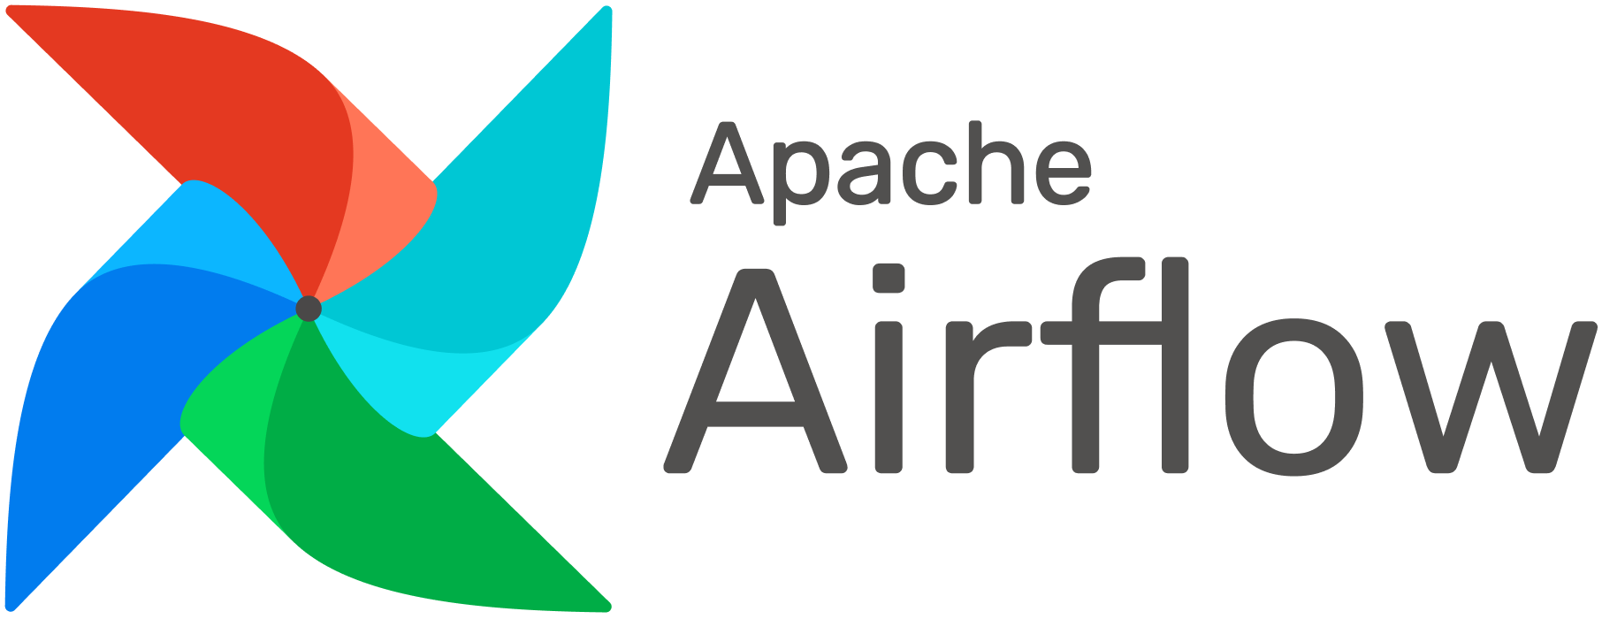

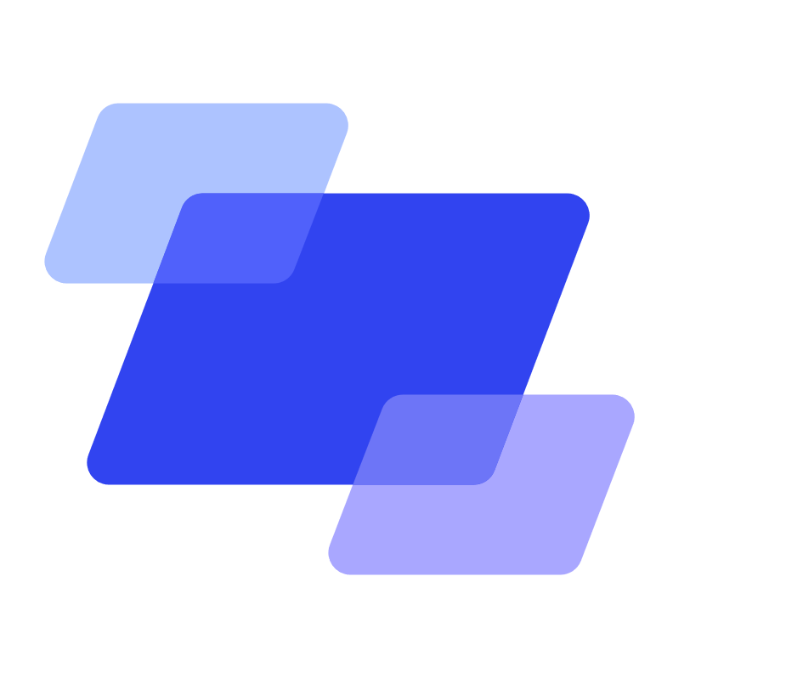


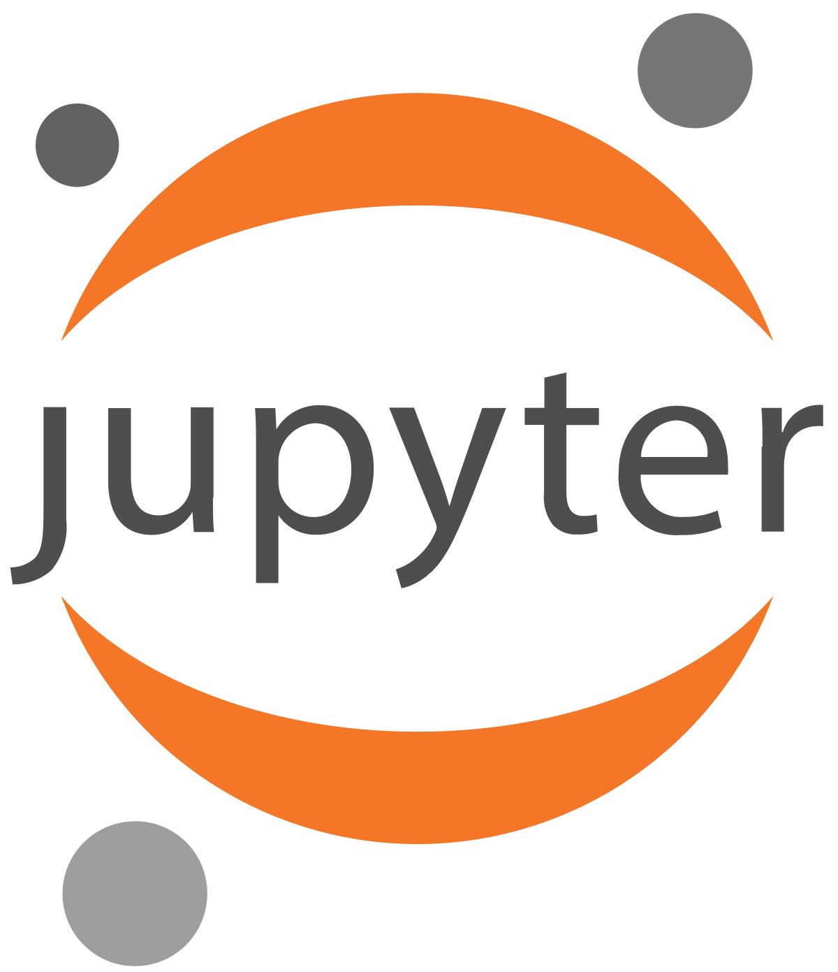




2 | Synergies of LDF Data Platform within SDC Delivering comprehensive value across all roles in the LDF Data Platform
Data Pipeline
Data Engineer
…
Data Catalog
Data Orchestration
Data Transformation
Data Ingestion
Data Transformation
Concept & Bus. glossary
Data Analysts
…
Data Catalog
SQL Engines
SQL Engines
Data Science
Personas Platform Users
Data Scientists
…
Data Catalog
Data Science
Data Science
Data Transformation
Business User
…
Dashboards & Reports
Dashboards & Reports
Dashboards & Reports
General User
…
Dashboards & Reports
Dashboards & Reports
Dashboards & Reports

Slide 11



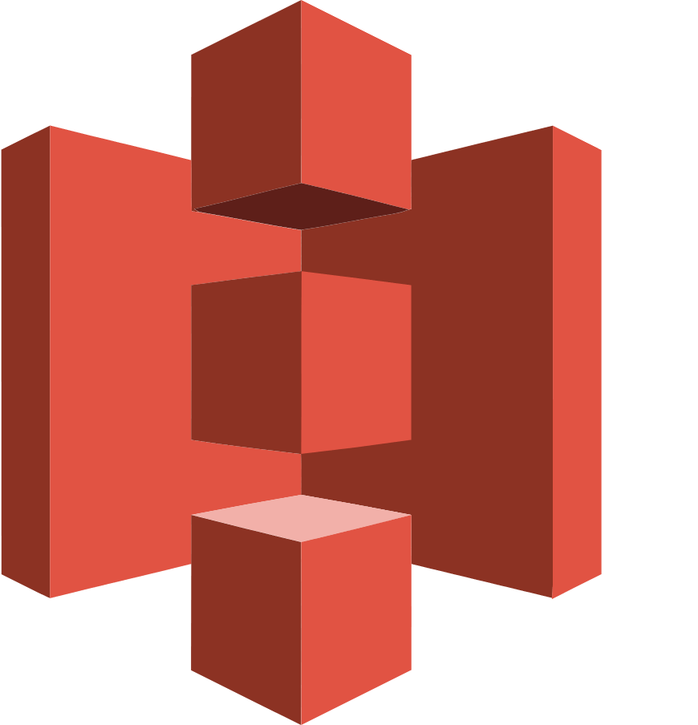

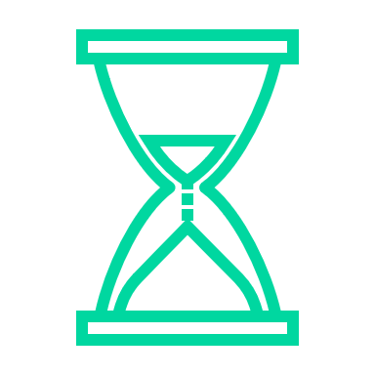


2 | Synergies of LDF Data Platform within SDC Success Story CATE@MFK
Work in Progress
Preliminary figures
Benefits
File
Duration
AWS Costs
4x more tester types
2,5x more machines
3x more files
Before: Files from APT tester type (8 machines) Now: Files from SPI (5), AOI (13), APT (8) and AXI (2)
50% reduction of implementation time
Before: 6 month Now: 3 month
~25% reduction of the AWS operational costs
Before: 900€ / month Now: 690€ / month
Time to Query
Time to Query
Integration with Snowflake
Storage Costs
Everything serverless (SaaS)
> Decoupled, easy to scale, resilient architecture
Before: S3, Lambda, Kinesis, Glue, Athena
Now: S3, Lambda, Kinesis, Glue, Athena
4x faster
time to market
Before: 12 minutes Now: 3 minutes
No extra effort for exposing Iceberg tables in Snowflake
Before: Extra job and storage Now: Native Iceberg Integration
50% reduction of storage costs
Before: 24,50€ / TB / month Now: 13€ / TB / month

Slide 12
Agenda
1
Status Update LDF Data Platform
2
Synergies of LDF Data Platform within SDC
3
Introduction to Hybrid Architecture Concept
4
Project Ambition Fiscal Year 2024

Slide 13




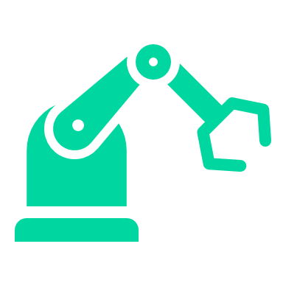

3 | Introduction to Hybrid Architecture Concept Unlocking Data-driven Agility: Understanding the Nature of Hybrid Architecture
Overview
Characteristics
GenAI
PLM
IEE
Cloud Layer
Enrichment with data from the cloud
Cloud services for intensive data science tasks that require large computing power
Hybrid architecture combines the best of on-prem and cloud, enabling selective usage and real-time adaptability to evolving business demands.
ERP
AWS
LDF Data Platform
Connectivity Layer
Intelligent proxy server on factory level
Inherits decision rules for decisions on local and cloud data
Only relevant data is uploaded
Intelligent Proxy Server
Upload decision
Local Compute Power
Local Data Center
Local Storage
Shopfloor Layer
Management of heterogeneous machines and local data centers
Deletion of specific local data after 2 weeks (e.g., positive tests)
…
…
A Hybrid Architecture offers the FLEXIBILITY to tailor factory-specific deployment scenarios, achieve COST-EFFICIENCY through optimized pay-as-you-go models and enhance PERFORMANCE by strategically allocating resources between on-prem and cloud infrastructures.

Slide 14
Agenda
1
Status Update LDF Data Platform
2
Synergies of LDF Data Platform within SDC
3
Introduction to Hybrid Architecture Concept
4
Project Ambition Fiscal Year 2024

Slide 15
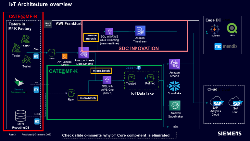
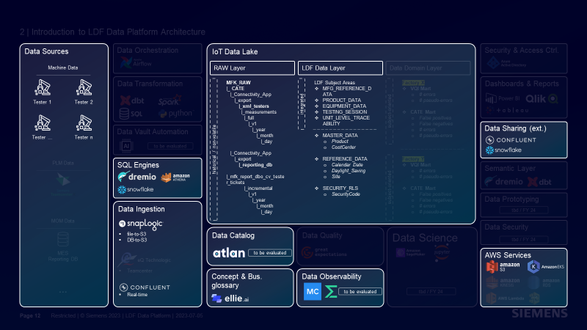
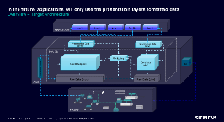
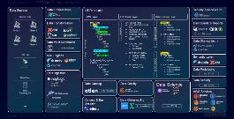
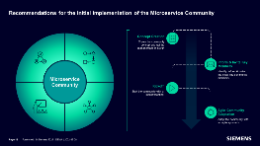
4 | Project Ambition Fiscal Year 2024 Plan for FY 24
Scale existing Use Cases
Roll-out existing use-cases in further factories such as CATE@GWE to enhance operations
Develop new Use Cases
Developing new use-cases to extend the product and service portfolio (e.g., Closed Loop SMT, PIP and PDA)
Extend Platform Capabilities
Extending the platform from basic to full blown scope enabling advanced capabilities such as data science, data prototyping, data security etc
Provide Expert Services and IT Support
Offer dedicated expert services and ensure 1st, 2nd and 3rd level IT support during the lifecycle
All activities within LDF Data Platform are and will be continuously aligned with XO Portfolio

Slide 16






LDF Data Platform FY24 (Enhancement and Rollout)
DESCRIPTION
Extend Platform Capabilities
Scale existing Use Cases
Develop new Use Cases on the platform
Provide Expert Services and IT Support
Continuous alignment with XO Portfolio
Responsibility
Achim Moosburger (DI IT DEMA ATR)
Katrin Weißmann (DI IT DEMA BDA)
OBJECTIVES
Budget
Extend Self-service portal for requesting cloud components in IoT Data Lake ➔ multi-cloud, solution blueprints, etc.
Conceptual and logical design ➔ Continue creation of common LDF Data Model for standardizing data analysis
Data Ingestion ➔ Standardization by creating data ingestion templates with SnapLogic
Data Catalog ➔ Implement data catalog for tracing lineage in data products and increase data literacy
Data Observability ➔ Increase trust on data in LDF Data Platform by automating the detection of data anomalies
Data Democratization ➔ Tools that allow non-technical users to interact with the data and generate insights
Data Science ➔ Accelerate and scale development, deployment and management of AI applications
280.000 € (FY23) – FA, MC (PA invested already in base concept)
480.000 € (FY24) – FA, MC, PA
Duration
FY23: 04/2023 – 09/2023
FY24: 10/2023 – 09/2024
BENEFITS
Cost Optimization: Decreasing operation costs for new use cases or onboarded factories
Scalability: Faster setup and implementation times of new use cases
Self Service: Enablement of IoT and Factory Use Cases with easy onboarding of required data
Analytics: Learning based on more connected data to enable factory networks and enablement of GenAI use cases
BUs & Workstreams
Proc.
DT
AMS
BDA
FA
PA
MC

Slide 17
Backup

Slide 18
4 | Project Ambition Fiscal Year 2024 What if we loose speed?
Chris
New
∑ 500 k €
Further Develop Platform
∑ 300 k €
Multiple Use Cases for 1 Platform
∑ 200 k €
We build and evolve constantly
1 Platform for 3 Use Case
01
Evolution of Platform
Data Security
Advanced capabilities for Data Science
Data democratization (Jupiter example)
Advanced GenAI capabilities
Evolving platform for multicloud
SnapLogic templates (file transfer)
Stay as is (frozen) minimal bug fixing
02
How many projects and use cases can be realized
+ Visual quality inspection (image processing) use cases
+ (see Use Case Prio: Federated learning, connectivity ..)
+ Development of one more use case in one factory
Migrate other CATE projects into a standard architecture
03
Evolution of Platform
L1 support ➔ IoT Squad
L2 support ➔ DA team
L3 support ➔ SaaS vendors
Intermediate support IoT Squad and escalation to Intelizign or AWS
Current CATE@MFK support model - support IoT Squad and escalation to Intelizign or AWS
Service im project scope
Onshore support to speed up roll-out
Support by Project Team

